Slide 1
Putting Image Manipulations in Context:
Robustness Testing for Safe Perception
Trenton Tabor, Senior Robotics Engineer
National Robotics Engineering Center
Zachary Pezzementi, Trenton Tabor, Samuel Yim, Jonathan K. Chang, Bill Drozd, David Guttendorf, Michael Wagner and Philip Koopman
“Robustness Inside-Out Testing (RIOT).” NAVAIR Public Release 2018-165. Distribution Statement A – “Approved for public release; distribution is unlimited”
Notes:
Hi! I’m trent

Slide 2
Acknowledgements
This project was funded by the Test Resource Management Center (TRMC) Test and Evaluation / Science & Technology (T&E/S&T) Program through the U.S. Army Program Executive Office for Simulation, Training and Instrumentation (PEO STRI) under Contract No. W900KK-16-C-0006, “Robustness Inside-Out Testing (RIOT).” NAVAIR Public Release 2018-165. Distribution Statement A – “Approved for public release; distribution is unlimited”.
We also thank other authors for making code public to enable this work.
Notes:
Before I get into my talk, I must acknowledge our funding source, the US Army TRMC, and mention that this information has been approved for public release.
I also want to point out that this work would not be possible without open source code, so thank you to everyone whose work we build on

Slide 3
Major Take-Aways
Small image changes can have catastrophic effects on safety critical perception.
In fact, common image degradations can often cause such failures for systems running over long periods.
We demonstrate this on many state-of-art fieldable systems within a framework for evaluating robustness in adverse conditions.
Notes:
Really briefly, I want to tell you why this work is important

Slide 4
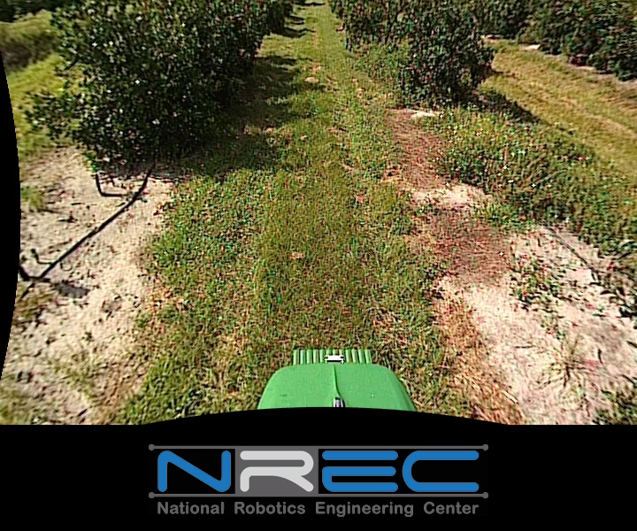
Previous Work – Person Detection
Person detection is one sample safety-critical application now dominated by deep-learning-based approaches.
Experiments in this work use NREC Agricultural Person Detection Dataset, largest public dataset for off-road person detection
T. Tabor et al. “People in the weeds: Pedestrian detection goes off-road.” In 2015 IEEE International Symposium on Safety, Security, and Rescue Robotics (SSRR).
Z. Pezzementi et al. “Comparing apples and oranges: Off‐road pedestrian detection on the National Robotics Engineering Center agricultural person‐detection dataset.” Journal of Field Robotics, 2018.
Notes:
Our group has been working on new datasets and tools for evaluating perception systems for autonomous vehicles for years. In fact I presented some early work on a large scale public dataset at the last North American SSRR in 2015.
We’ve still been using this dataset in our development of new tools, including in this work. We encourage you to download it and use it yourselves.

Slide 5
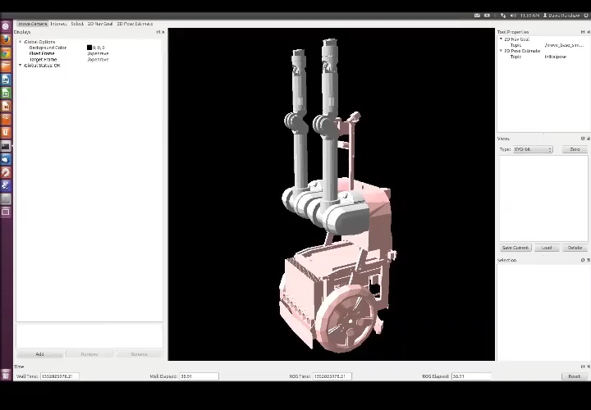
Philosophy of Approach –
Robustness Testing for Perception
Chose to partner with the robustness testing group at our University
  Robustness Testing is the process of generating many queries of a system and requires knowledge of what wrong behavior is for these inputs.
  This technique has found real, dangerous bugs
  Previously tested 17 robotic systems over several years
  An example, shown, is finding a planner ignoring constraints, leading to erratic behavior
C. Hutchison et al. “Robustness testing of autonomy software.” International Conference on Software Engineering, 2018.
Applying to perception…
  Perception systems have such high dimensional inputs to make pure generation of new inputs impractical.
  We propose instead using physically grounded mutations of previously labeled data to create exceptional inputs.

Slide 6
Details of Approach
From Philosophy
We propose using physically grounded mutations of previously labeled data to create exceptional inputs.
We built a list of degradations that occur in outdoor imaging
We implemented parameterized mutators modeling some of these
We used these mutated datasets to estimate robustness of safety critical machine learning systems

Slide 7
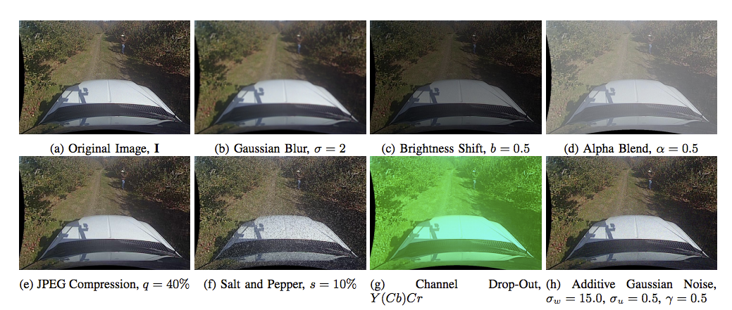
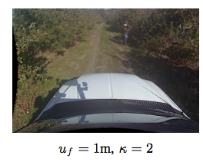
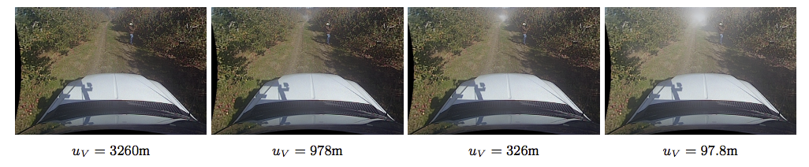
Mutators Used
All are literature backed degradations
See paper for details and model references
Defocus
Haze
Contextual Mutators
Notes:
More time, point to original, call attention to many

Slide 8
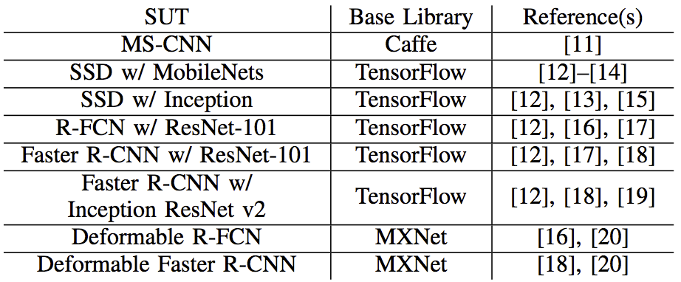
Detectors Tested
Many state-of-the-art object detectors from some of the most popular deep network frameworks

Slide 9
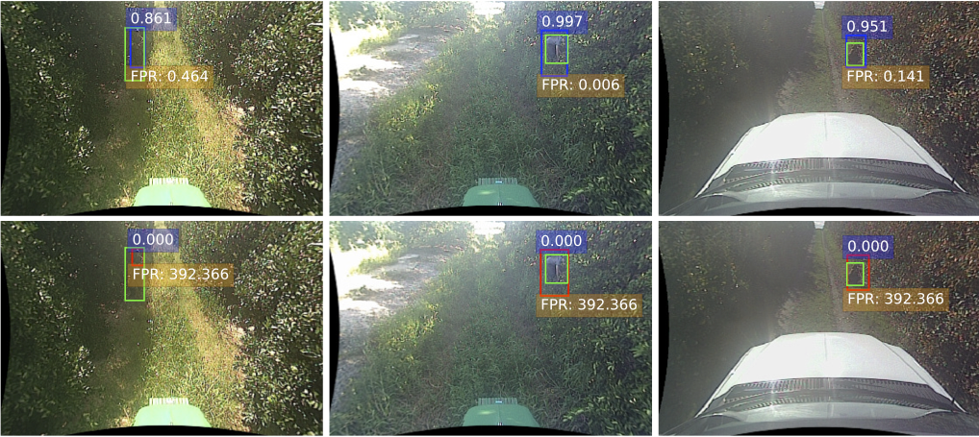
Striking Results
Small changes to images, even physically realistic changes, can cause a catastrophic change in classifier performance
Ground Truth Label
Raw Detection Strength
Required False Positive Rate
Original
Mutated
MSCNN detections on original images and under moderate blur

Slide 10
Sample Results: Channel Dropout
Channel dropout is devastating to most detectors
Original Image
Drop Channel Cb (YCbCr)
Better
Worse
Notes:
Mention worse first, then the weird fact of improvement

Slide 11

Sample Results: Haze
There is variation in detector robustness to haze
Original Image
Haze w/ 97.8m Visibility ($β$ 0.04)
Better
Worse
Notes:
Consider repeating claim of physical realism “coolness”

Slide 12
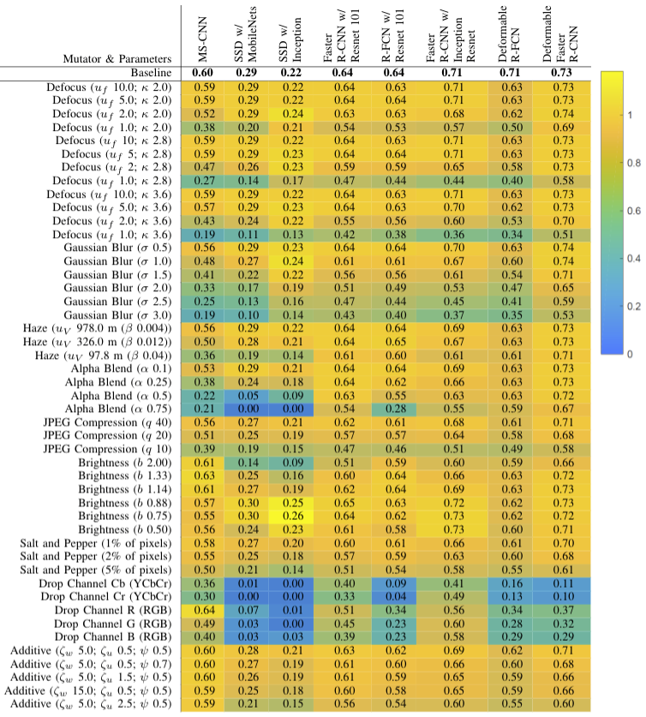
Full Results
Evaluated full combination of mutators and detectors
Allows analysis of general robustness characteristics of each detector
Sometimes would change choice of best detector, depending on importance of adverse conditions to you

Slide 13
Threats to Validity (And Future Work)
Generalization outside our chosen detection algorithms
  New systems are developed all the time, and each has a configuration space
Generalization across performance metrics
  We chose detection accuracy, but there are many other options
Generalization outside our dataset
  Focused on an off-road dataset, there are many domains where autonomous vehicles are applied
Generalization outside our chosen mutators
  Future mutators may have radically different effects on detectors
Notes:
While {positive thing} these trends may not hold for {generalization}

Slide 14
Major Take-Aways
Small image changes can have catastrophic effects on safety critical perception.
In fact, common image degradations can often cause such failures for systems running over long periods.
We demonstrate this on many state-of-art fieldable systems within a framework for evaluating robustness in adverse conditions.
Notes:
Really briefly, I want to tell you why this work is important

Slide 15
Adversarial Perturbations
We already know modern object detectors’ behavior can change drastically from small changes to an image.
Those behavior changes can be critical to safety.
But what if we are not worried about adversarial inputs?
Detected as:
“Bus”
Adversarial
Noise
Detected as:
“Ostrich”
Szegedy et al. “Intriguing properties of neural networks”. arXiv 1312.6199

Slide 16
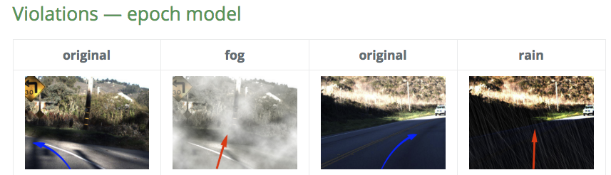
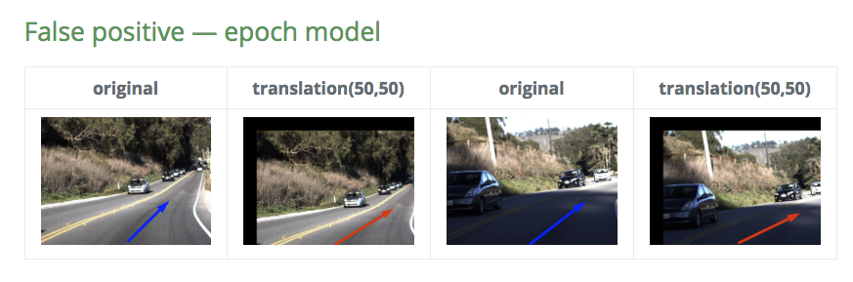
Related Work - DeepTest
Apply mutations to images and evaluate effect on system learned to produce steering angles
Our approach’s differences:
  Physically realistic mutators
    Better match what real systems may encounter
    Ensure ideal output should not change
  Large-scale evaluation
    Dataset size
    # Mutators
    # Algorithms
  Evaluate person detection
Y Tian et al. “Deeptest: Automated testing of deep-neural-network-driven autonomous cars.” ICSE, 2018.

Slide 17
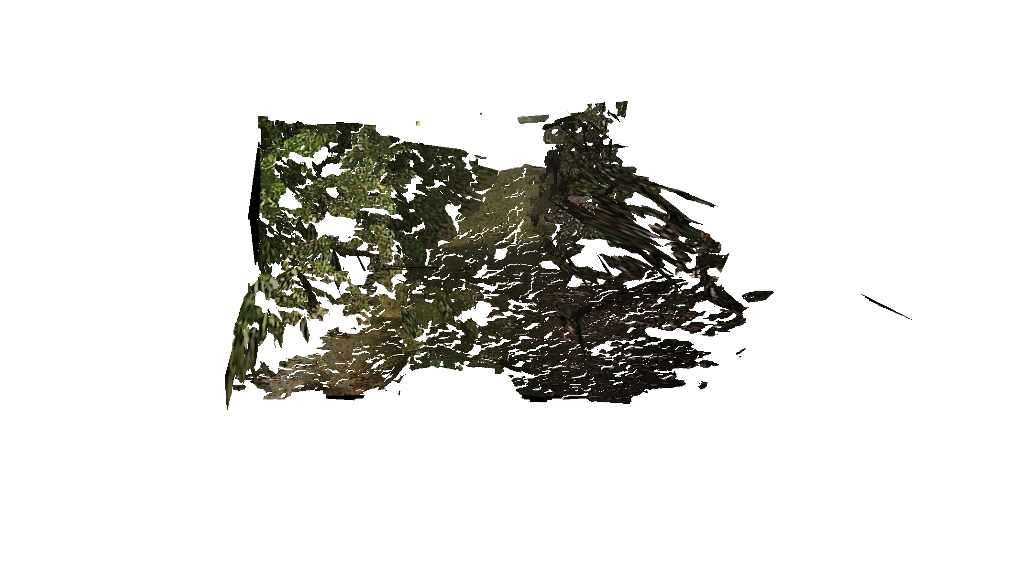
Contextual Mutators
We implemented two mutators that depend on the geometric structure of the scene, defocus and haze:
  Estimate scene geometry in each frame from stereo video using scene flow¹ and bilateral filtering²
  Mutate images based on estimated depth to each pixel:
    Defocus – Based on depth-dependent blurring
    Haze – Based on depth-dependent alpha-blending
Mesh of typical reconstruction
¹ Vogel et al. “3D Scene Flow Estimation with a Piecewise Rigid Scene Model”. IJCV 2015.
² Barron and Poole. “The Fast Bilateral Solver”. ECCV 2016.
Typical defocus mutation

Slide 18
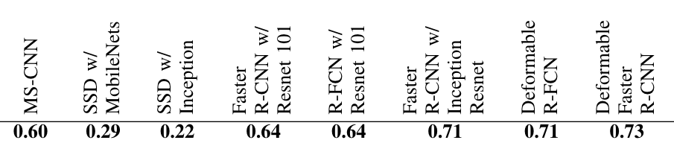
How We Evaluate Detection Performance
Detections and ground truth are bounding boxes around people.
We consider multiple Intersection-over-Union (IoU) thresholds for whether to consider a detection “correct”.
Then we average area under the ROC curve for each to get a single number for overall detection performance.
Z. Pezzementi et al. “Comparing apples and oranges: Off‐road pedestrian detection on the National Robotics Engineering Center agricultural person‐detection dataset.” Journal of Field Robotics, 2018.

Slide 19
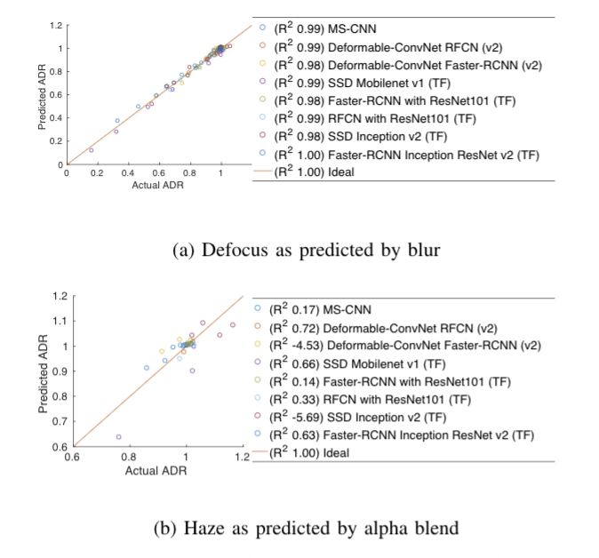
Predicting Contextual Mutators
For each contextual mutator, we have a simple equivalent that does not require geometric context:
Can performance under contextual mutators be predicted from simple mutators?
Works well for predicting Defocus from Gaussian Blur
Works poorly for predicting Haze from Alpha Blend
Simple | Contextual
Gaussian Blur | Defocus
Alpha Blend | Haze

